Slide 1
Panda Express
5B
Aidan Thomas, Brady O’Connor, Brianna Bach
Daniel Lam He, Zach Assad

Slide 2
Agenda

Slide 3
Agenda
Team Members and Roles
Overall Picture of Project
Development Methodologies
Project Status and Outlook

Slide 4
Team Members

Slide 5
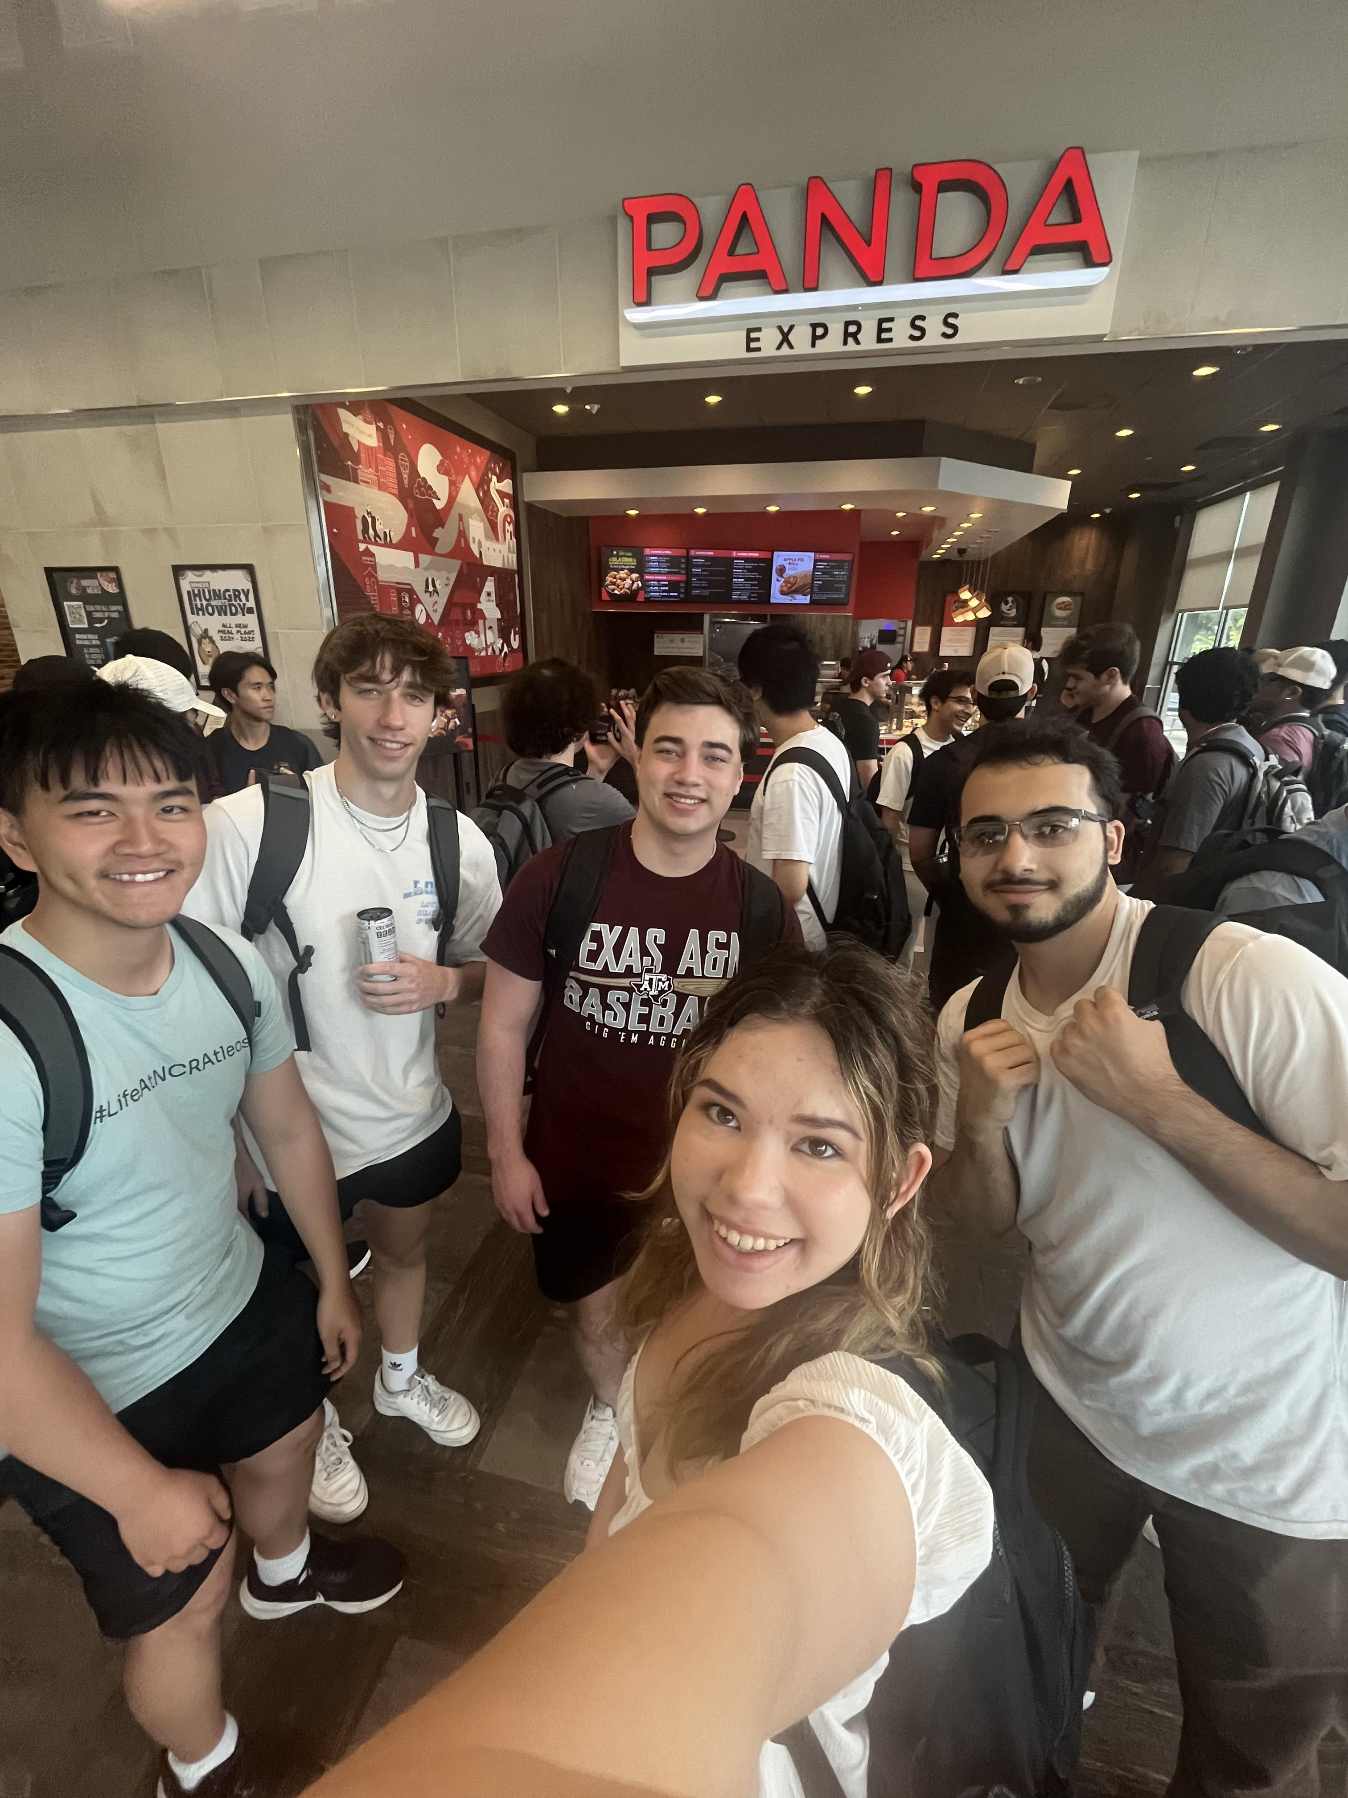
5B - Bulbasaur
Every team member is doing full stack. Emphasis for each:
Daniel Lam He: Project Manager and technical reporter
Brianna: Usability testing specialist and back-end
Zach Assad: Back-end
Brady O’Connor: Front-end
Aidan Thomas: Back-end and usability testing

Slide 6
Overall Picture of Project

Slide 7

Product Idea
Upgrade to the POS ordering system into a fully functional web application.
Key focus: collecting and using user feedback for development.
This upgrade will contain more capabilities and user accommodations.

Slide 8
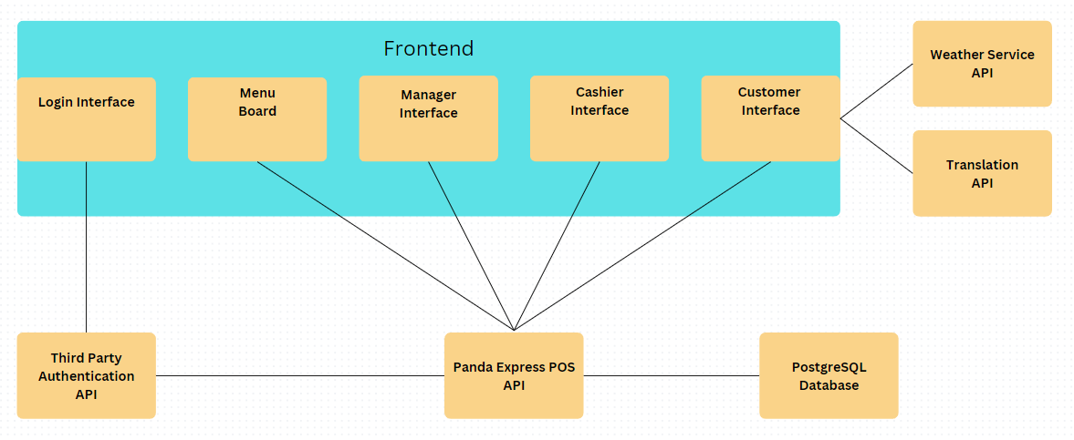
Project Details
Pages for different roles: Manager, customer, cashier, and menu board
Login functionality for managers and cashiers using Google Oauth
Frontend will use weather service, translation, and Google OAuth API’s
Custom POS API integrated with PostgreSQL to provide real-time data to the frontend
High-Level Design
Notes:
For Manager: sales reports, inventory management, cashier management, and menu items management.

Slide 9
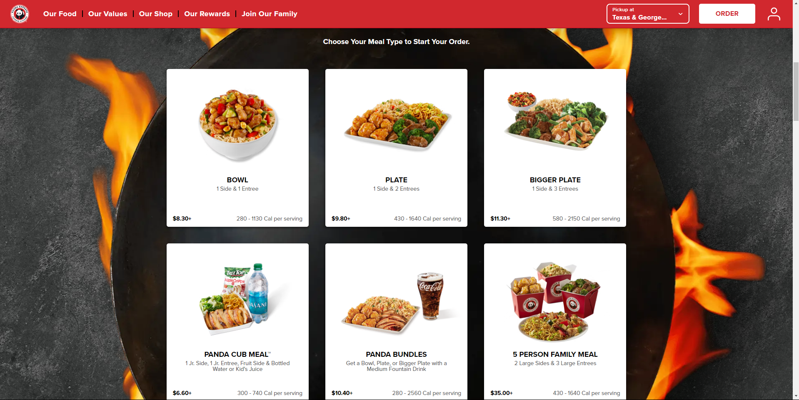
State-of-the-Art
Our product aims to streamline customer interaction to accommodate all customers and employees efficiently.
Our website is currently in development and not fully functional.
Self-service order flow that doesn’t redirect users to another page.
High contrast modes and text modifications for universal accessibility.
Competing technologies

Slide 10
Development Methodologies

Slide 11
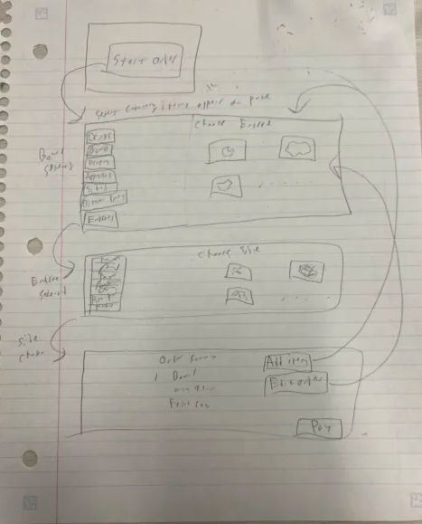
Lo-fi Prototyping
Focused exclusively on the self-service customer ordering page.
All self-service interactions are designed to fit within a single page for simplicity.
Menu items are displayed on the left side of the screen.
Item selections and customization options are shown in the center.
The checkout section appears as the final step, providing a seamless order review and payment process.

Slide 12
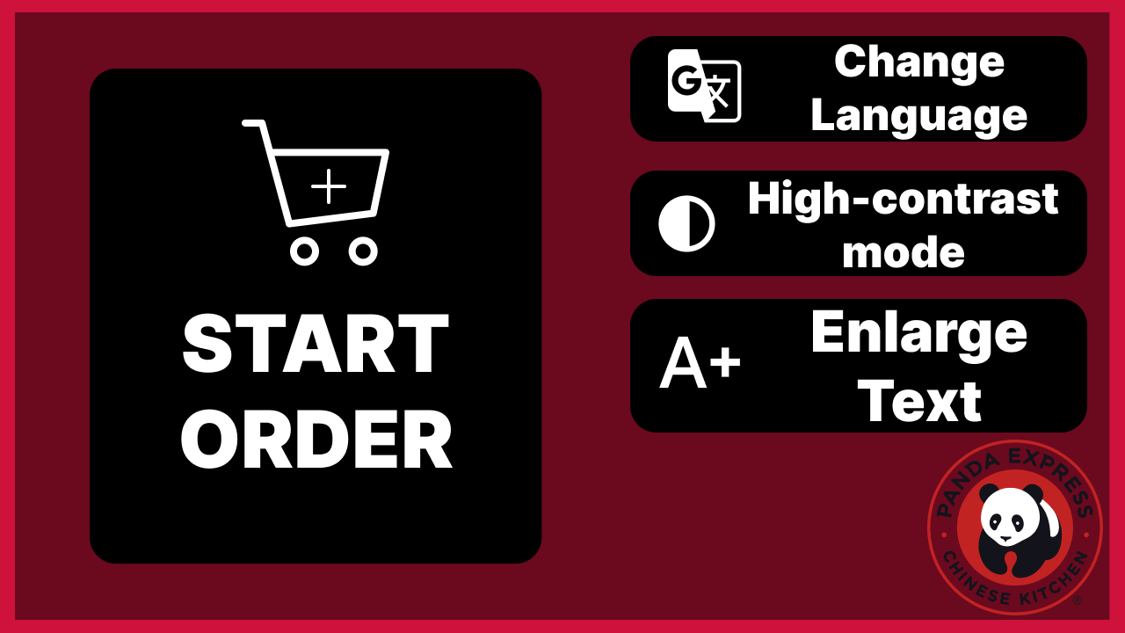
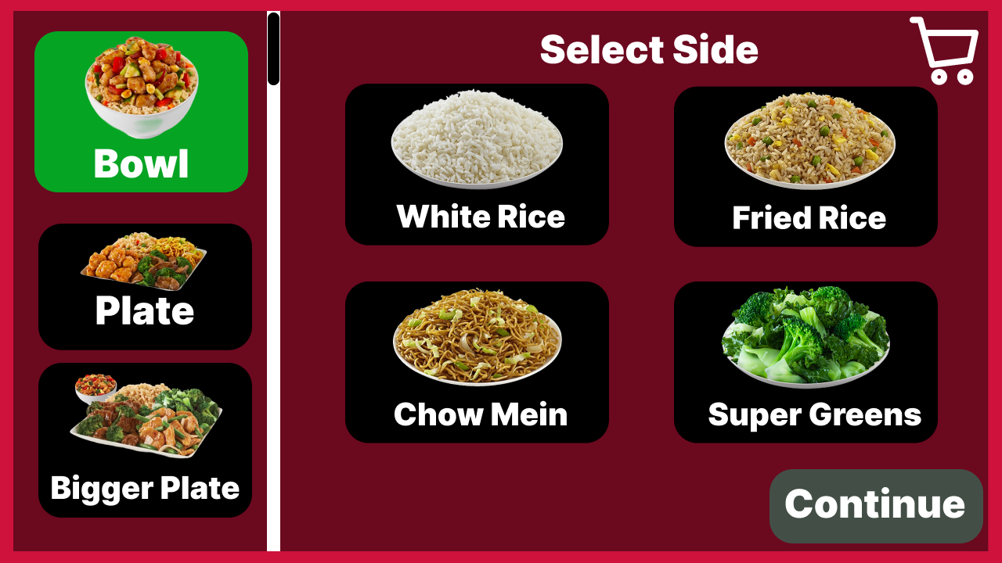
Hi-fi Wireframes
Enhanced user-friendliness with clear, intuitive icons.
Accessibility features include translation options, high-contrast mode, and adjustable text size for improved readability.
The self-service order remains on a single page for streamlined user experience and efficiency.

Slide 13
User Study Feedback
Improvements suggested:
Bigger texts and images to the menu board
Back button
Better color scheme
For ordering, menu items be buttons, images be present, and indicate where to click.
Next steps:
New accessibility page
More appealing design
Add buttons
Accessibility tools in all pages.
Were you able to access everything that you wanted to?
Was not able to use the accessibility buttons and the functionality did not work.
How would you rate the look of the website from a scale of 1 to 10 and explain why.
Visually it looked good, however there could be some improvements
What are some challenges as to inputting your order and explain why.
Did not realize to click on the menu item buttons

Slide 14
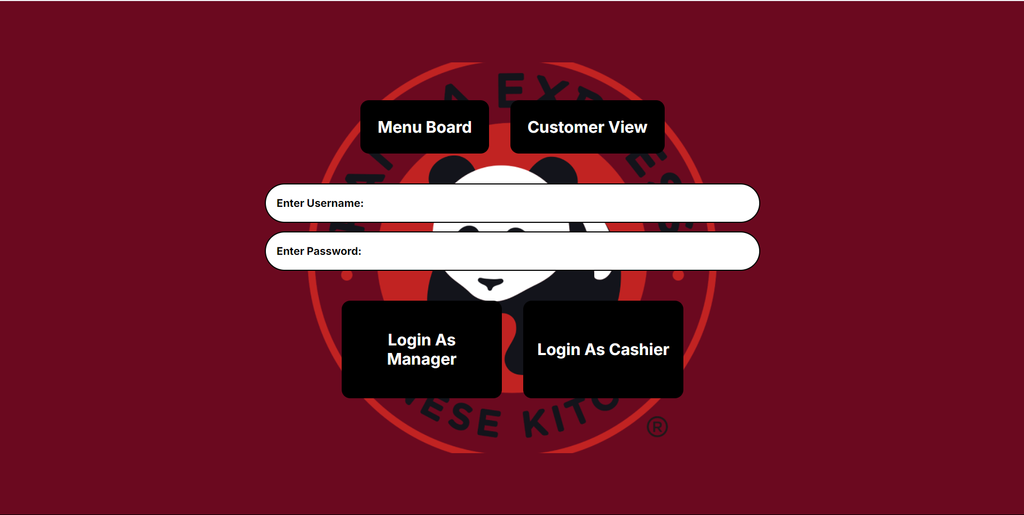
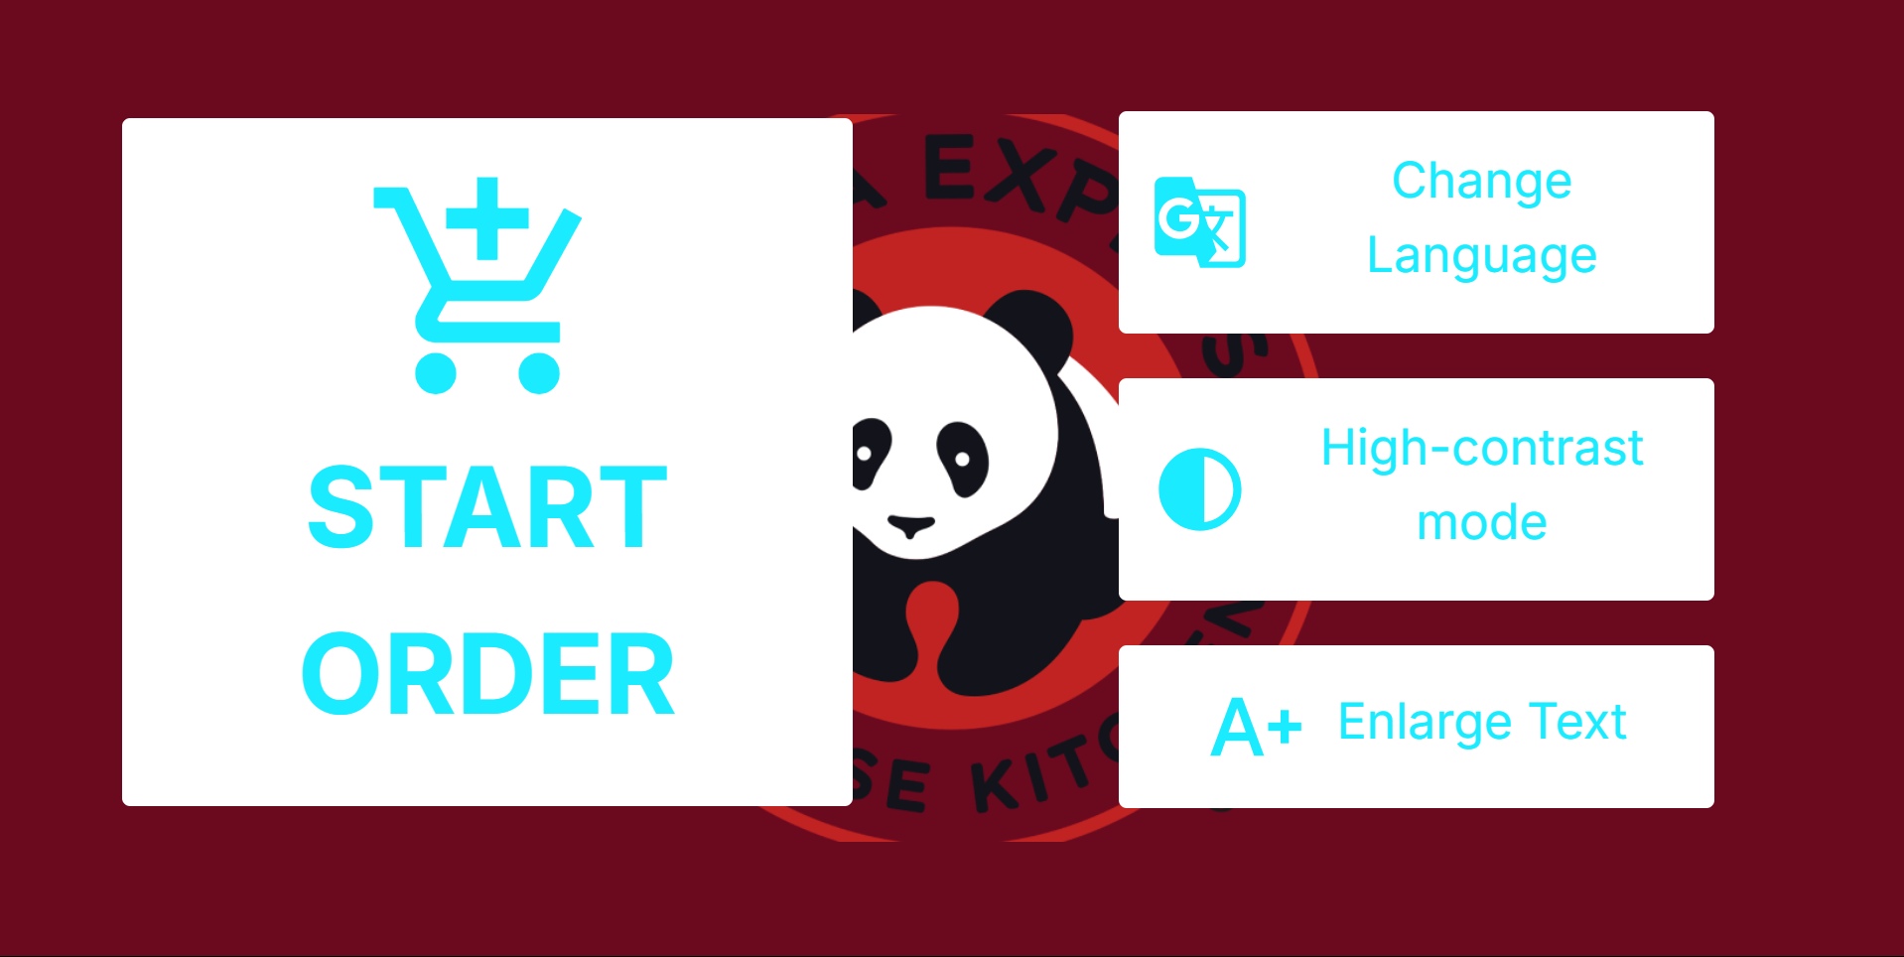
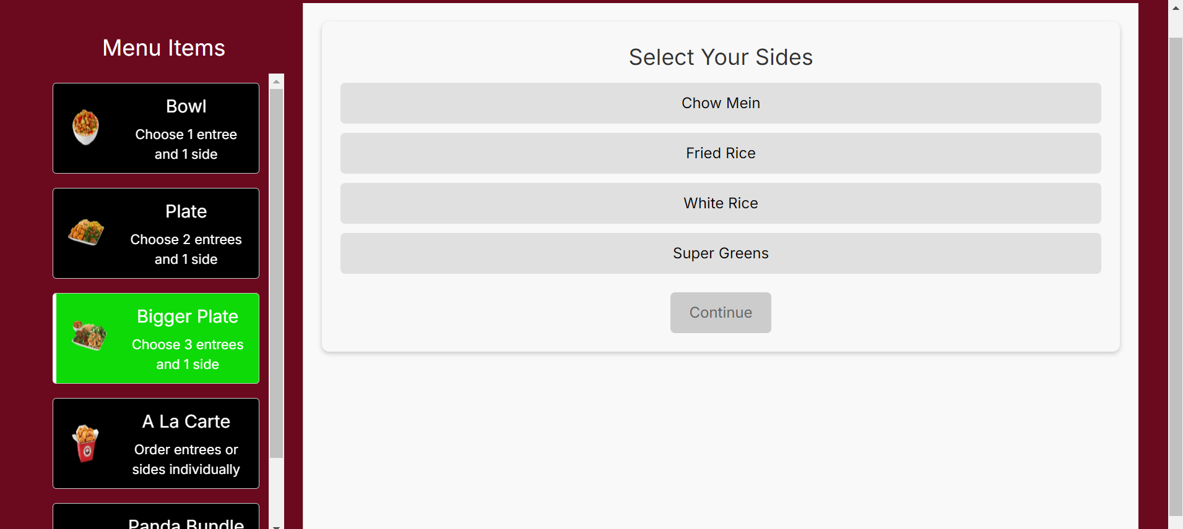
Frontend Development
Developed in React JS.
Self-service page reused for the cashier page.

Slide 15
Backend Development
Developed in Node.js
<Representative image of team's backend development efforts>

Slide 16
Full Stack Development
<List of summary points for full stack development methodologies.>
<Representative image of team's full stack development efforts>

Slide 17
Project Status and Outlook

Slide 18
Product Backlog Summary
The project setup is complete.
Customer Interface is complete
¼ of the manager interface completed
½ of cashier interface completed
Front-End and Backend deployed.
Task Category | Task Description
Project Setup | Complete Project Design for POS System
Project Setup | Set up GitHub repositories for front end and back end
Customer Interface | Design and develop Self-Service Order Landing Page
Customer Interface | Create Menu Page
Customer Interface | Add Navigation Bar
Manager Interface | Design Manager Dashboard with Role-Specific Navigation and Sales/Inventory Reports
Cashier Interface | Reuse Customer Page
Cashier Interface | Add Role-Specific Navigation for Cashier
Accessibility | Translation, High contrast mode, and text resizing
Deployment | Deploy website and backend API
Authentication | Implement Google OAuth and role-based access control
Error Handling | Implement frontend and backend error handling
Display Interface | Design Display-Only Interface for Large Screens

Slide 19
Sprint 1 Status
Design and Management Document completed
Customer self-service fully functional
Readjustment of estimate points (we underestimated)
Login and manager page not functional but started.
Menu Board hardcoded menu items
<Burndown chart of Sprint 1.>

Slide 20
Sprint 2 Outlook
Task Category | Task Description
User Feedback | Address feedback from User Study
Accessibility | Add Language Toggle for multi-language support on the kiosk
Accessibility | Implement High-Contrast Mode for improved visibility
Accessibility | Add Text Resize and Text-to-Speech Options for better readability and accessibility
Manager Interface | Develop Inventory Management Page to view and manage ingredient stock
Manager Interface | Create Sales Report Page for real-time sales tracking and revenue performance
Manager Interface | Integrate Inventory Usage Report to track ingredient consumption
Manager Interface | Add Role-Specific Navigation for easy access to Inventory and Sales Report pages
Authentication | Implement working login feature with Google OAuth
Cashier Interface | Complete Checkout Functionality to finalize the customer order process
Address feedback of User study
Complete Accessibility feature
Finalize half of functionality for manager page
Fully working checkout functionality.
Working login

Slide 21
Sprint 3 Outlook
Finalize other half of manager page.
Take menu items from DB for Menu Board.
Ensure robustness of website by checking error handling.
Cashier should view previous orders.
Task Category | Task Description
User Feedback | Address feedback from User Study
Accessibility | Add Language Toggle for multi-language support on the kiosk
Accessibility | Implement High-Contrast Mode for improved visibility
Accessibility | Add Text Resize and Text-to-Speech Options for better readability and accessibility
Manager Interface | Finalize Menu Item Management functionality for the Manager Page
Manager Interface | Finalize Admin Management functionality for the Manager Page
Menu Board | Fetch and display menu items from the database for the Menu Board
Website Robustness | Implement comprehensive error handling to ensure robustness of the website
Cashier Interface | Add functionality to view previous orders for supporting customer inquiries

Slide 22
Overall Project Outlook
Sprint 2:
Login for Cashier and Manager
Accessibility Functionality
Complete Checkout functionality for taking order.
Sprint 3:
Finalize Manager page.
Ensure robustness of the website.
Dynamic Menu Board.
Cashier can view previous orders

Slide 23
Additional Thoughts

Slide 24
Additional Thoughts
Questions
Concerns
<List of questions.>
<List of concerns.>

